Slide 1

Principles

Slide 2
Outline
Programming Principles
  DRY
  KISS
  Document your Code
  Refactor
Project
Interview Questions

Slide 3
Programming Principles
It's easy to write code. It's challenging to write good code. Bad code comes in many forms. Messy code, massive if-else chains, programs that break with one adjustment, variables that don't make sense—the program might work once, but, if put to the test, will never be able to stand strong. If you want to become a programmer, never settle for shortcuts. Aim to write code that is easy to maintain easy for you to maintain, and easy for any other developer on your team to maintain.
How do you write effective code? Programming principles will make you a better coder.

Slide 4
DRY
Don't repeat yourself (DRY) is a principle of software development aimed at reducing repetition of software patterns. The DRY principle is stated as "Every piece of knowledge must have a single, unambiguous, authoritative representation within a system". The principle has been formulated by Andy Hunt and Dave Thomas in their book The Pragmatic Programmer.

Slide 5
KISS
Keep it simple, stupid (KISS) is a design principle which states that designs and/or systems should be as simple as possible. Wherever possible, complexity should be avoided in a system—as simplicity guarantees the greatest levels of user acceptance and interaction.

Slide 6
Document your Code
Documenting code is part of writing good code

Slide 7
Refactor
It's hard to accept, but your code isn't going to be perfect the first time. Refactoring code means reviewing your code and looking for ways to optimize it, making it more efficient while keeping the results exactly the same.
Codebases are constantly evolving. One of the principles of programming is remembering that it's completely normal to revisit, rewrite, or even redesign entire chunks of code. It doesn't mean you didn't succeed the first time you wrote your program; you're inevitably going to get more familiar with a project over time. Use that knowledge to adjust yourself as you make progress.

Slide 8
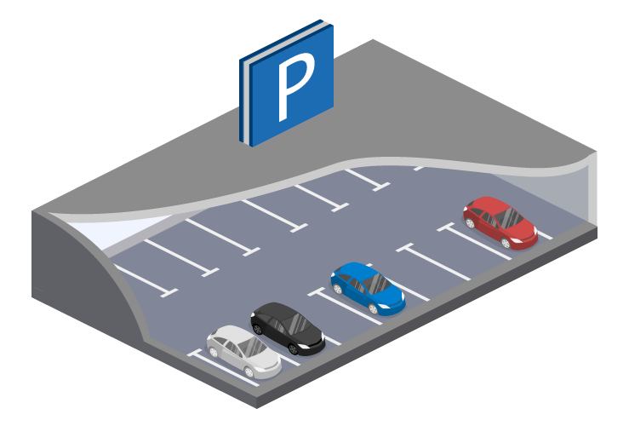
Parking
https://www.piliapp.com/emoji/list/car/

Slide 9
Interview Questions

Slide 10
Success is the sum of small efforts, repeated day in and day out.

